Slide 1



Cyber Warfare Engineer Mission
Who We Are: Cyber Warfare Engineers (CWE) are the highly-technical computer scientists and computer engineers who research, design, develop, test and evaluate software and firmware for computer network attack, exploitation and defense in cyberspace operations. They possess significant experience and technical expertise in Computer Programming (languages), Computer Architecture & Operating Systems (theory & application), Networks (protocols, programming & technology) and Security (application, encryption, network security).
What We Do:
  Provide defense against attacks and deliver tactical advantages
  Develop tools and techniques in the information environment that ensure situational awareness
  Serve as a key part of the Information Warfare Community in its mission to gain a deep understanding of the inner workings of adversaries and developing unmatched knowledge of the battlespace during wartime

Slide 2
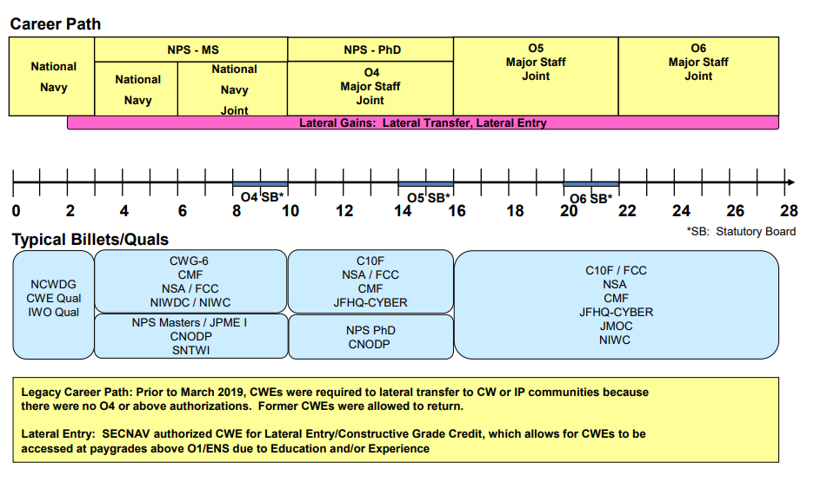
Cyber Warfare Engineer Officer
Career Progression
2

Slide 3
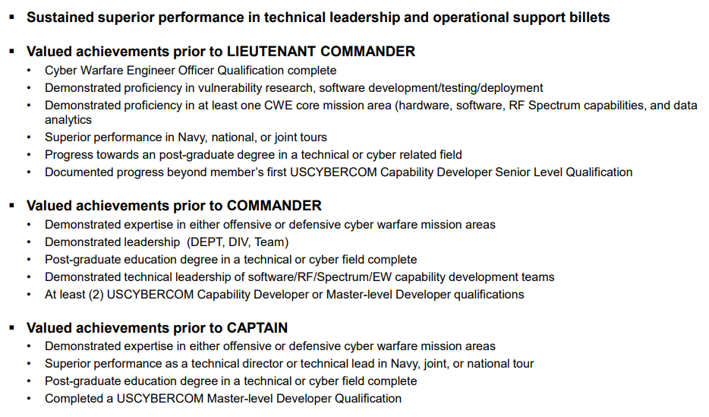
Cyber Warfare Engineer Officer
Community Values

Slide 4
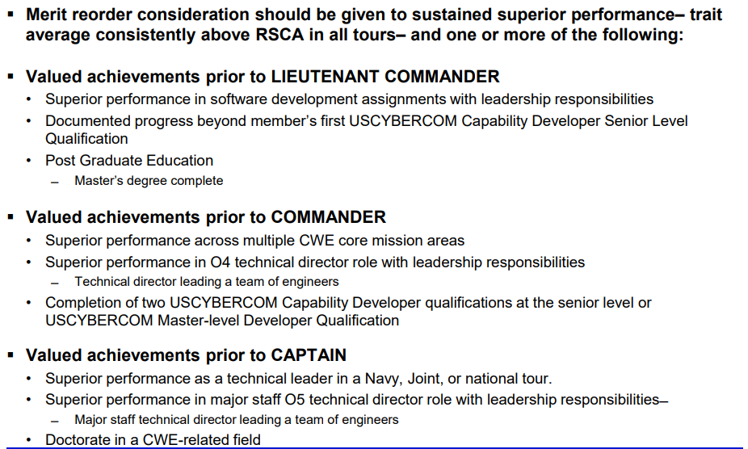
Cyber Warfare Engineer Officer
Merrit Reorder Considerations

